Slide 1
DEALER SCHEMES

Slide 2
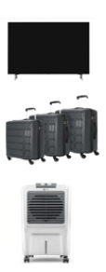
DEALER SCHEME MAY JUNE JULY 2025
BILLING AMOUNT (EXCL GST) | REWARD
BUY NEELAM GOODS WORTH RS. 3,00,000 | GET A 42 inch TV/ Neelam Product FREE worth MRP 44,990
BUY NEELAM GOODS WORTH RS. 1,50,000 | GET A TROLLY SET 3 PC/ Neelam Product FREE worth minimum MRP 20,990
BUY NEELAM GOODS WORTH RS. 75,000 | GET A COOLER/Neelam Product FREE worth minimum MRP 8,990
Terms & Conditions:
Above scheme is on Box and KG items only under Neelam Brand
Payment Terms - not exceeding 45 Days from the date of Billing
Orders to be processed on SWIFT Application Only.
Subject to Distributor’s Approval

Slide 3
MERCHANDISE FOR DEALER OFFER
BILLING AMOUNT (EXCL GST) | Q1 2025 | Q2 2025 | Q3 2025 | Q4 2025
Download SWIFT and place order worth 90,000 | Get Neelam Merchandise Set x 4 | Get Neelam Merchandise Set x 4 | Get Neelam Merchandise Set x 4 | Get Neelam Merchandise Set x 4
Download SWIFT and place order worth 60,000 | Get Neelam Merchandise Set x 3 | Get Neelam Merchandise Set x 3 | Get Neelam Merchandise Set x 3 | Get Neelam Merchandise Set x 3
Download SWIFT and place order worth 30,000 | Get Neelam Merchandise Set x 2 | Get Neelam Merchandise Set x 2 | Get Neelam Merchandise Set x 2 | Get Neelam Merchandise Set x 2
Download SWIFT and place order worth 15,000 | Get Neelam Merchandise Set x 1 | Get Neelam Merchandise Set x 1 | Get Neelam Merchandise Set x 1 | Get Neelam Merchandise Set x 1
Terms & Conditions:
Above scheme is on Box and KG items only under Neelam Brand.
Payment Terms not exceeding 45 Days from the date of Billing.
Orders to be processed on SWIFT Application Only.
Subject to approval from Authorised Distributor.
Merchandise set includes 2x Pen, 1xPoncho, 2xWriting Pad, 2 x Cap, 2x Blue t shirt, 5 x Shopping Bag worth Rs. 900. (MRP approx. 2000)

Slide 4

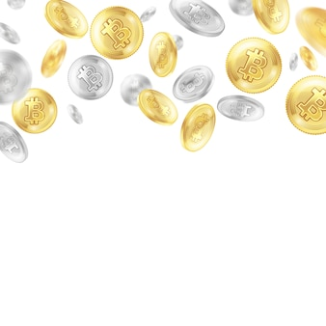
SONA CHANDI SCHEME
ANNUAL TURNOVER in INR (Excl. GST) | PRIZE OFFER
1,00,000 TO 2,00,000 | 10 Gram SILVER Coin
2,00,001 TO 3,00,000 | 30 Gram SILVER Coin
3,00,001 TO 4,00,000 | 60 Gram SILVER Coin
4,00,001 TO 5,00,000 | 2 Gram 22 Carat Gold Coin
5,00,001 TO 6,00,000 | 3 Gram 22 Carat Gold Coin OR Domestic Trip worth the amount
6,00,001 TO 7,00,000 | 4 Gram 22 Carat Gold Coin OR Domestic Trip worth the amount
7,00,001 TO 8,00,000 | 5 Gram 22 Carat Gold Coin OR Domestic Trip worth the amount
8,00,001 and Above | 5 Gram 22 Carat Gold Coin + 2N 3D Regional Trip as per zone.
Terms & Conditions:
Payment Terms 45 Days from the date of Billing
Orders to be processed on SWIFT Application Only.
Regional trip will be announced by 1st May 2026 eligible for only 1 person per retail outlet.

